Slide 1
Advanced higher Graphic communication
DTP Benefits

Slide 2
Learning intentions & success criteria
Learning Intentions
Overview of the benefits of desktop publishing in practise and industry.
Success Criteria
State a number of benefits of desktop publishing.
Explain and justify your choices in any DTP document.

Slide 3
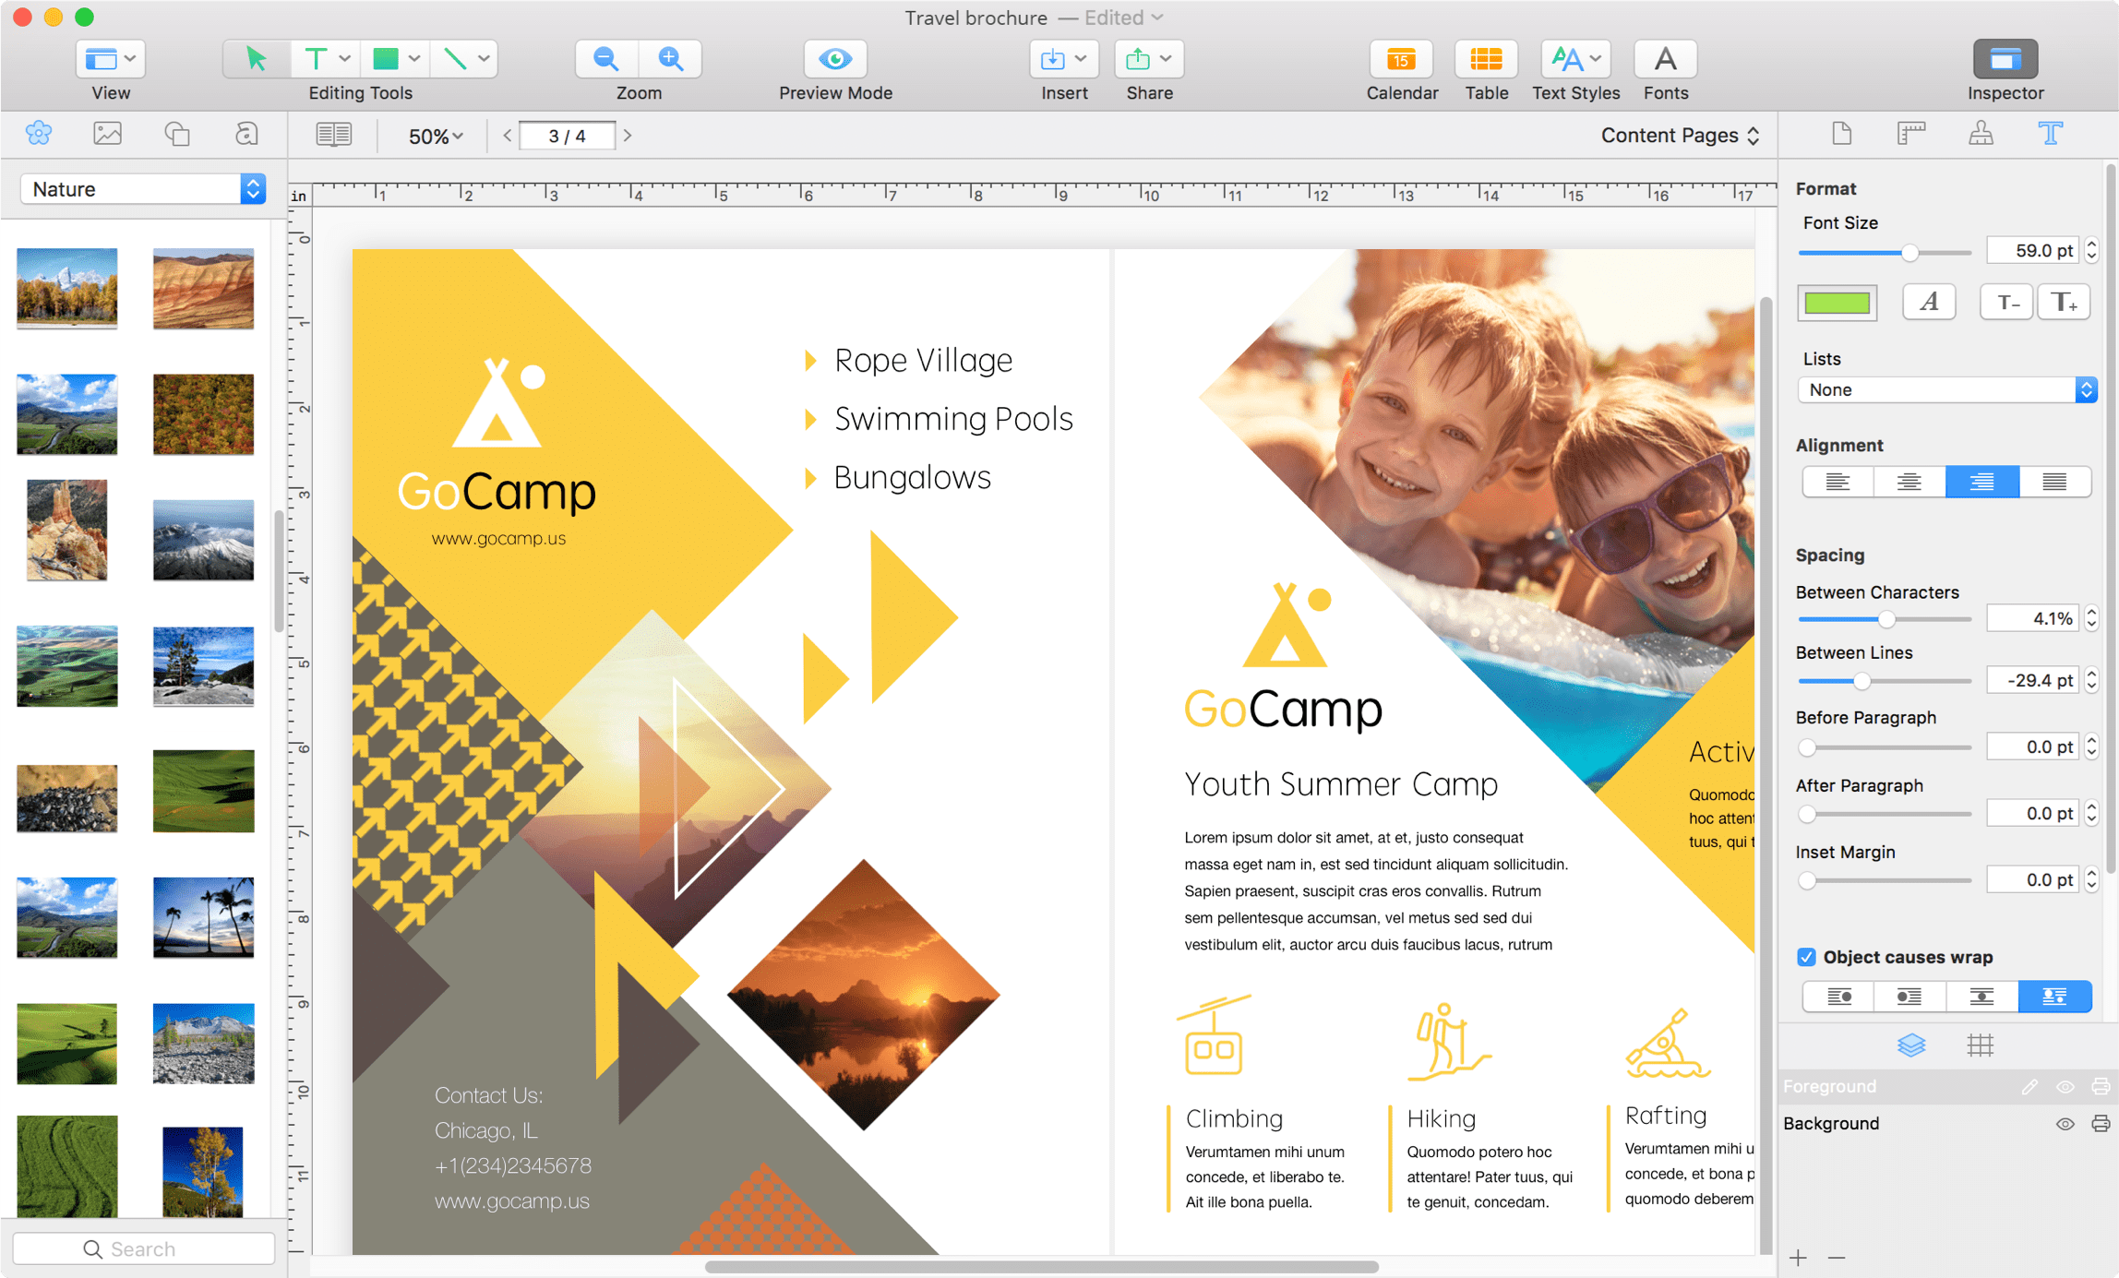
DTP benefits
Using DTP allows companies to improve page layout and create an effective design by balancing the contrast, space and colours to grab the attention of consumers.

Slide 4
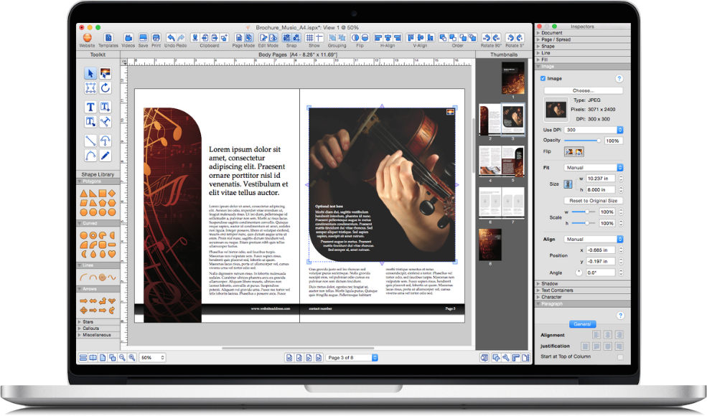
Dtp benefits
An enhanced appearance with an attractive page layout will encourage consumers to buy a product increasing sales revenue.

Slide 5
Dtp benefits
DTP can allow a document to be customised to target a particular consumer.

Slide 6
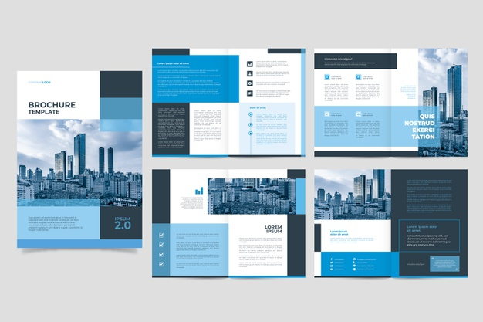
Dtp benefits
Templates with common features can be produced to reduce the time and cost required to produce page layouts.

Slide 7
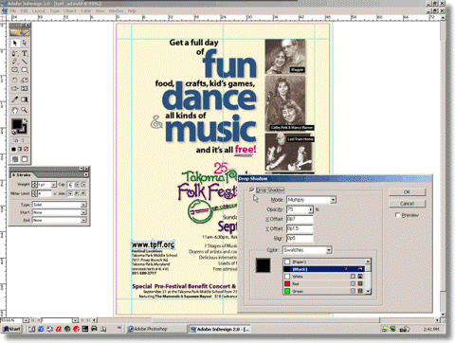
Dtp benefits
Layouts can be constructed accurately using grid, guidelines, snap, align, scale, rotate and crop functions.

Slide 8
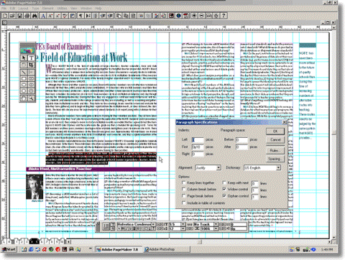
Dtp benefits
Modifications can be made quickly and easily using DTP editing tools.

Slide 9
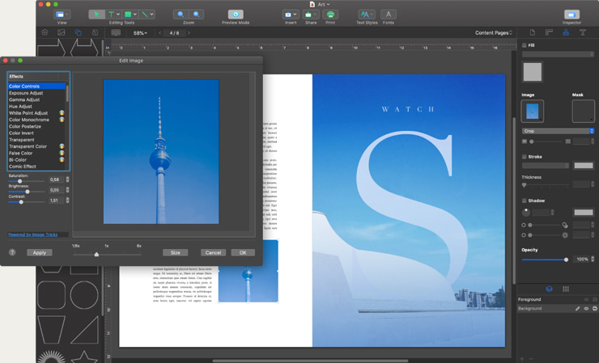
Dtp benefits
Images can be edited and manipulated easily: colour, size, cropping and shaping can all be edited creatively.

Slide 10
Dtp benefits
The time it takes to design and publish a document (the lead time) is greatly reduced.

Slide 11
Dtp benefits
The quantities of paper and inks can be controlled digitally to minimise waste.

Slide 12
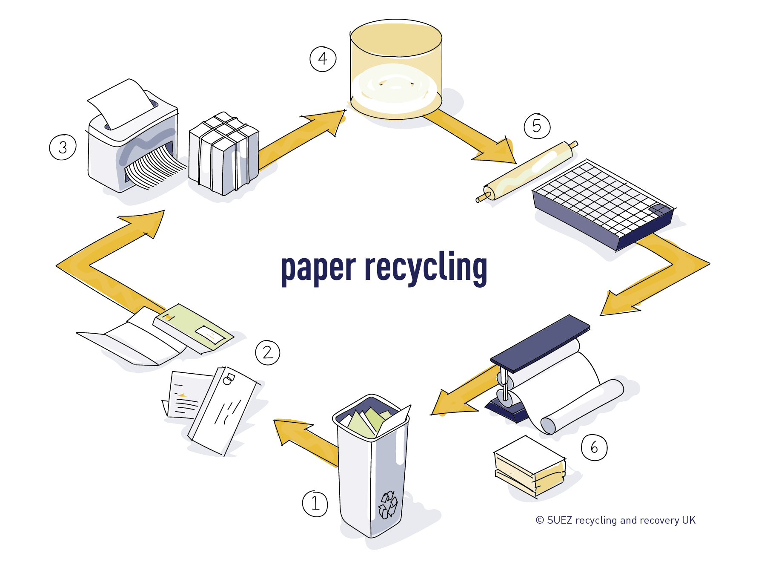
Dtp benefits
Modern printing technology can use paper that is 100% re-cycled without loss of quality.

Slide 13
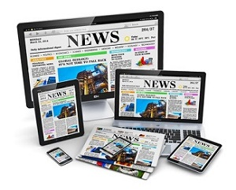
Dtp benefits
Electronic newspaper and news feeds / websites further reduce the use of paper.

Slide 14
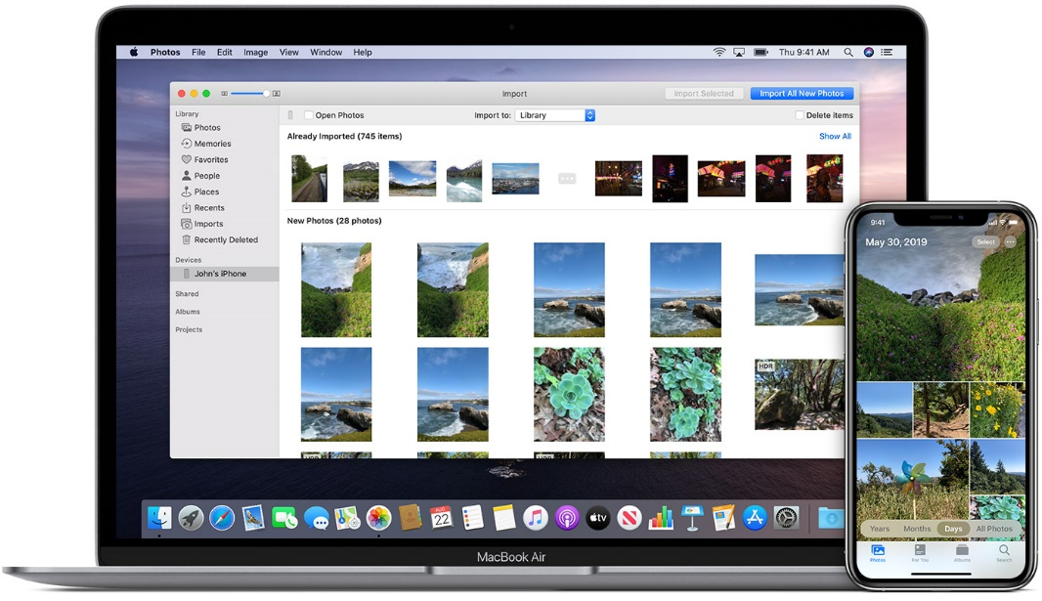
Dtp benefits
Text and graphics can be imported electronically from remote locations around the world.

Slide 15
Dtp benefits
Files can be sent electronically using email to the editor or client for approval.

Slide 16
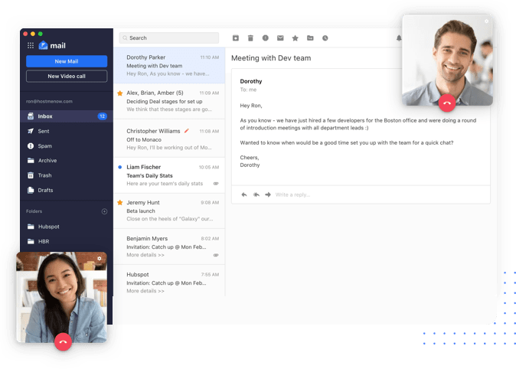
Dtp benefits
Communication between the graphic designer, client and print company is easily done via email.

Slide 17
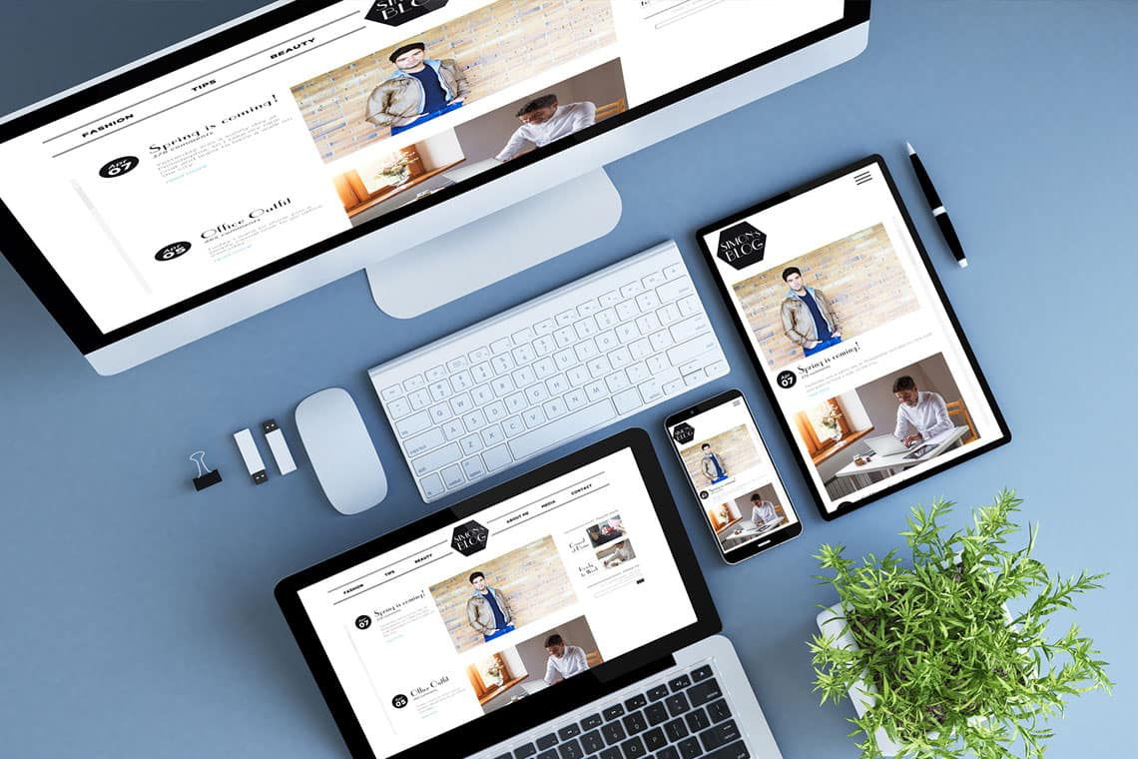
Dtp benefits
Websites can be viewed globally, developed in one country and posted in another.

Slide 18
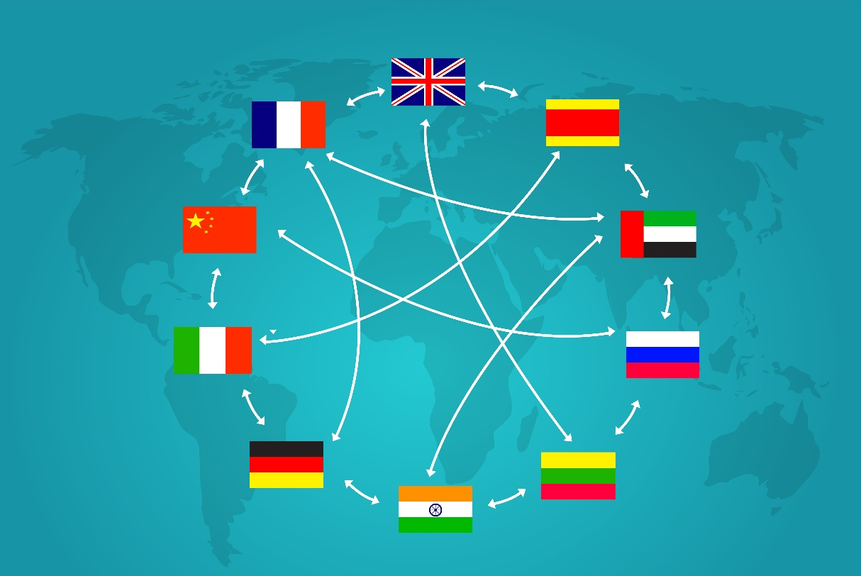
Dtp benefits
Websites can easily be made available in a variety of different languages.

